Slide 1
Student Engagement

Slide 2
Outline
Introduction
Engagement Types
Suggestions
Q & A

Slide 3
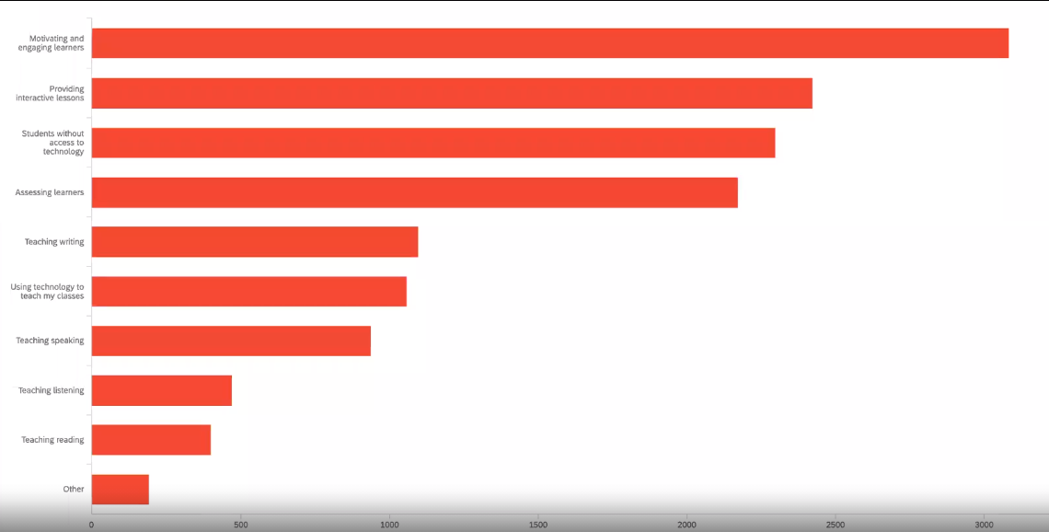
Nat Geo Survey

Slide 4
Attendance, Participation or Engagement?

Slide 5
Match!
A | B | C
Emotional, mental, behavioral, humanistic | Static and physical | Active and behavioral
Attendance,
Participation or
Engagement?
Maximizing Engagement

Slide 6
Engagement
A | B | C | D
Thinking Questioning Reasoning Analyzing Reflecting Evaluating | Interacting Collaborating Scaffolding Asking Responding | Respecting Appreciating Motivating Encouraging | Presenting Shooting a video Producing podcasts
Social
Behavioral
Affective
Cognitive
Maximizing Engagement

Slide 7
4 Types of Engagement
A) Peer feedback, discussion and group work
B) Following the lessons outside classroom
C) Synchronous interaction and assessment
D) Posing questions, answering questions
1. Learner-content
2. Learner-instructor
3. Learner-learner
4. Beyond classroom
Maximizing Engagement

Slide 8
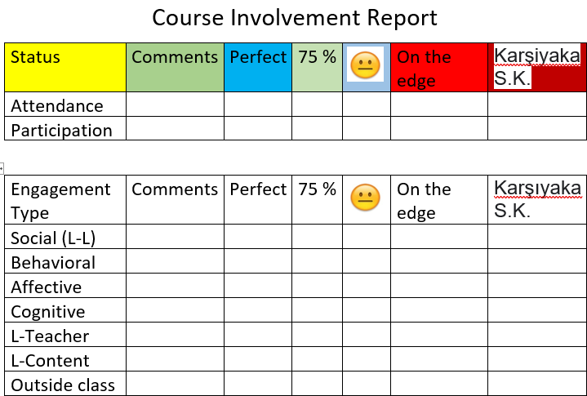

Slide 9
Engaging the learners

Slide 10
Learner Agency
Ownership
Control
Choice

Slide 11
Choice of
Seating arrangements
L1/L2: paradoxical timetabling
Assessment
Skills priority
Class rules
Games
Breaks
Resources

Slide 12
1. Student Presentations

Slide 13
2. Team Projects

Slide 14
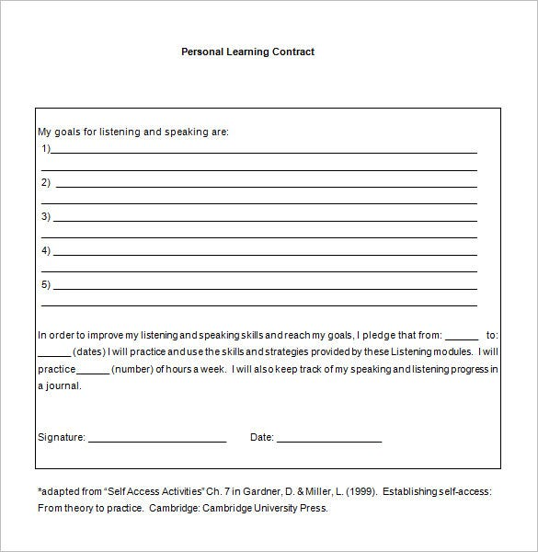
3. Assessment
20XX
Contract Learning Sample
Portfolio assessment
Contract learning
Notes:
Pear deck

Slide 15
5. Regular Feedback Sessions

Slide 16
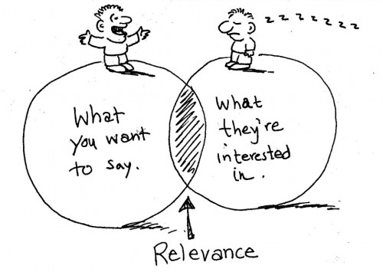
1. Relevance

Slide 17
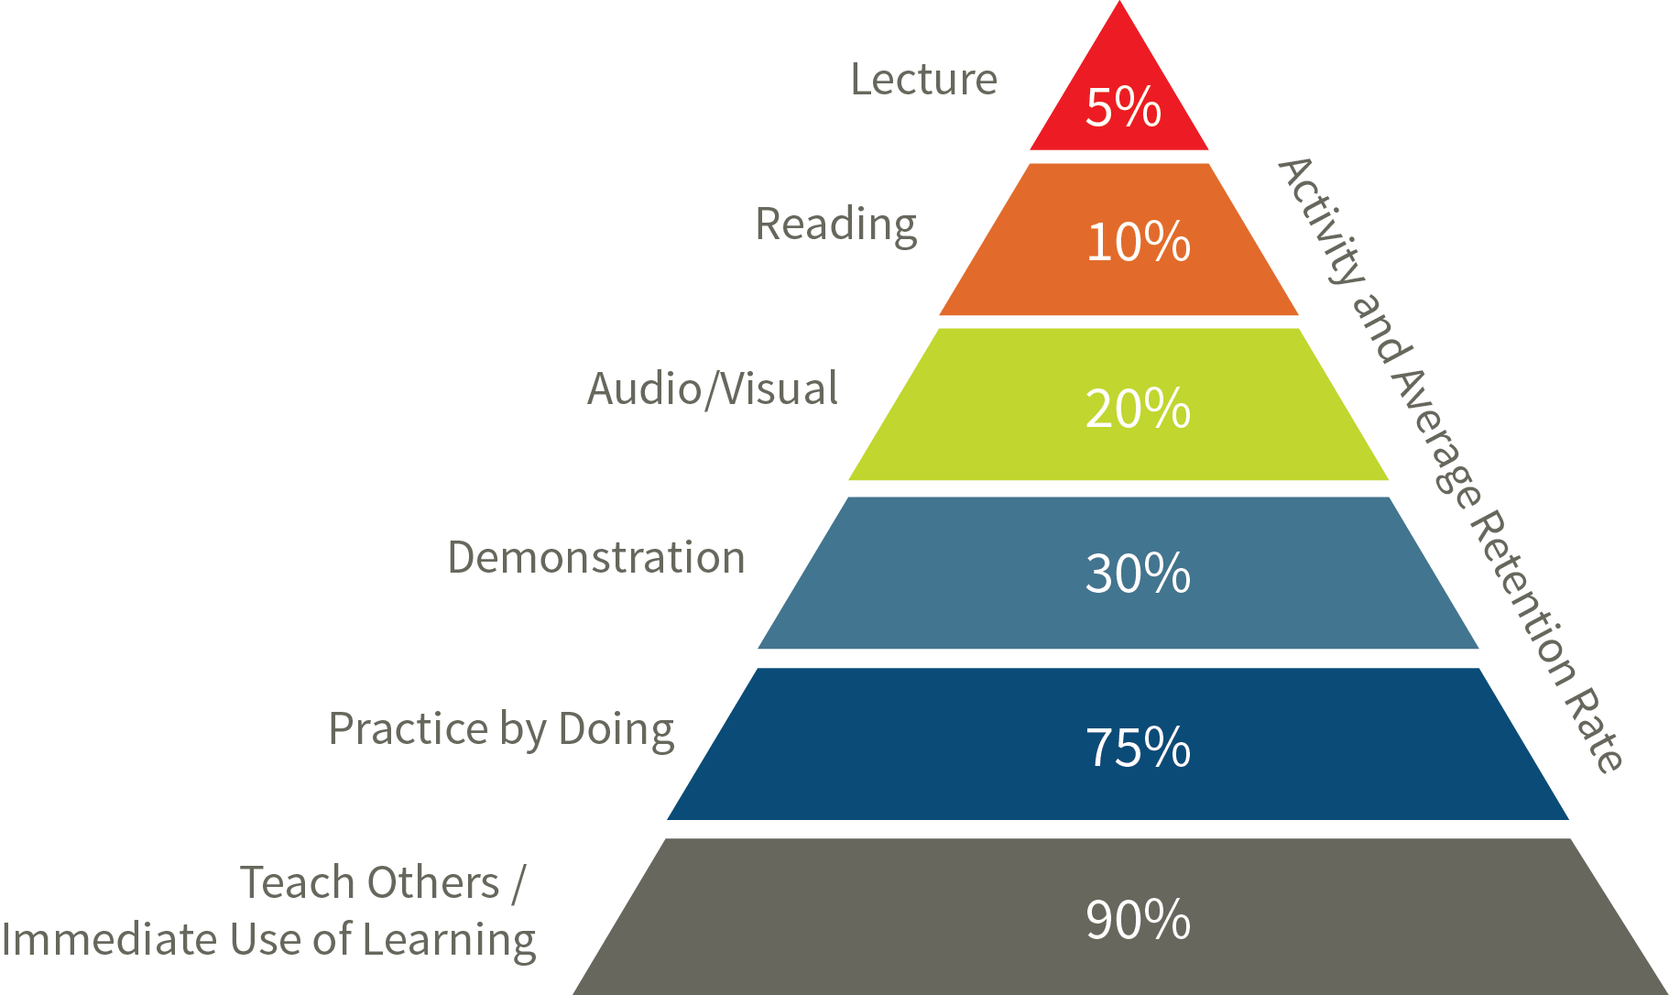
Demonstration
Reading
Lecture
Teaching others
Practice
Audio visual

Slide 18
Are you efficient?

Slide 19
4. Flip it!
Flipped Classroom

Slide 20
A suggested model
Phase 1
Phase 2:
Phase 3
Phase 4:
Self-study before class
Mediation activities
Teacher’s support
Problem based whole class

Slide 21
Self-study before class
Mediation activities
Teacher’s support
Problem based whole class

Slide 22
1. Interactive Lessons
An effective blend of HOT, LOT, Technology mediated and creative tasks

Slide 23
5. Clear Purpose
We study this lesson in order to..........
At the end of the unit teaching block, check to find out if the objective has been reached

Slide 24
5. Rapport

Slide 25
Know something specific about students’ personal life
Individual attention
Connection

Slide 26
5. Celebrate big/small achievements

Slide 27
In summary
Attendance, participation and engagement are different
Produce a weekly engagement report
To maximize the learners’ engagement:
give them some voice, choice and control

Slide 28
In summary
link the lesson to their lives
give student presentations
design interactive lessons
run portfolio assessment
flip the class

Slide 29
In summary
Use mediation skills
Design interactive lessons
show the clear purpose of each lesson
establish effective rapport with them

Slide 30
Thanks for Participating!
amir@kardes.com.tr

